Slide 1
Python week 4
Canberra Chinese School Sem2

Slide 2

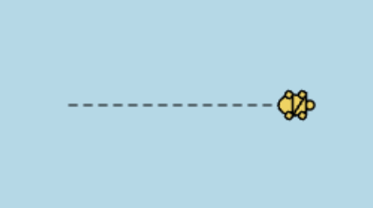
Turtle
Question: can we make a dashed line?

Slide 3
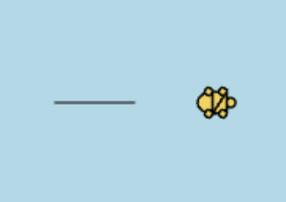

Turtle
New function: Penup()

Slide 4

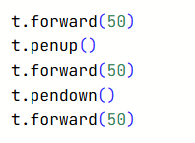
Turtle
New function: Pendown()

Slide 5
Turtle
Challenge: try to make a dashed line

Slide 6
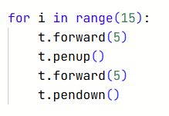
Turtle
Challenge: try to make a dashed line
One possible solution:

Slide 7
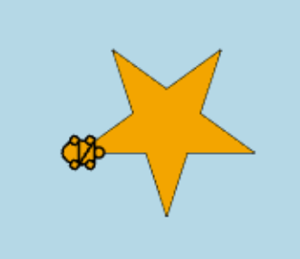
Turtle
New content: Fill

Slide 8

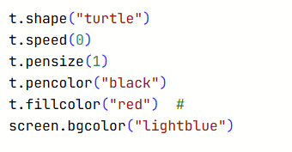
Turtle
In the “setting” section, add a new line:
You can change “red” to whatever colour you like

Slide 9
Turtle
In the “setting” section, add a new line:
You can change “red” to whatever colour you like

Slide 10
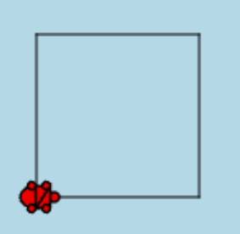
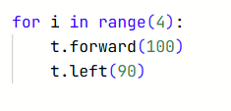
Turtle
Let’s draw a red square,
Currently, this draws the frame
Of the square

Slide 11
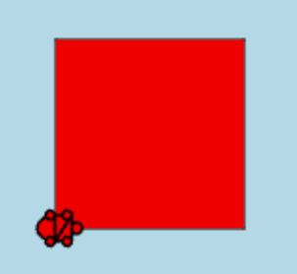
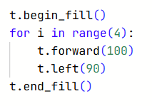
Turtle
Then enclose the whole for
Loop with begin-fill and
End-fill:

Slide 12
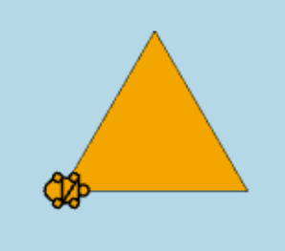
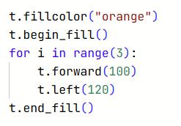
Turtle
Similarly, let’s draw a orange
Triangle:

Slide 13
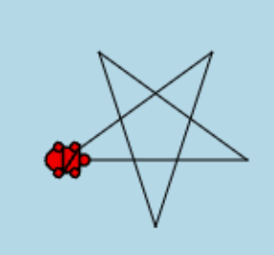

Turtle
Exercise: draw a colouored
5 pointed star. Remember, This
draws the frame of the star

Slide 14
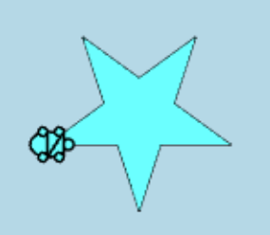
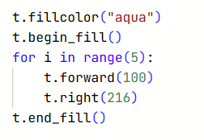
Turtle
Exercise: draw a colouored
5 pointed star. Remember, This
draws the frame of the star

Slide 15
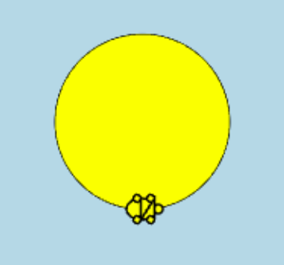
Turtle
Challenge: draw a coloured circle!

Slide 16
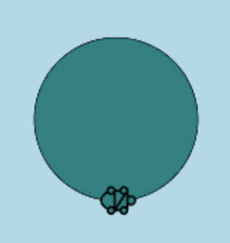
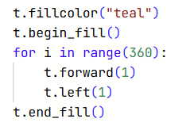
Turtle
Challenge: draw a coloured circle!

Slide 17
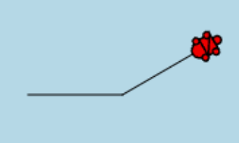
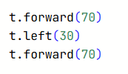
Turtle
Let’s try something a bit different…
What if we try to enclose this with begin-fill and end-fill?

Slide 18
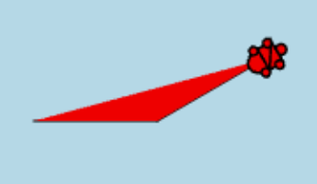
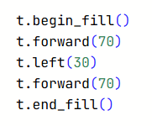
Turtle
Let’s try something a bit different…
What if we try to enclose this with begin-fill and end-fill?
It auto-completes the shape!

Slide 19
Turtle
Let’s try something a bit different…
What if we try to enclose this with begin-fill and end-fill?
So even if the shape isn’t closed, we can still colour it.

Slide 20
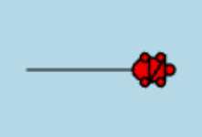

Turtle
However, this doesn’t work if you just have one line.

Slide 21
Turtle
Fun exercise! Choose your own adventure and create a cool looking shape with whatever you can do.

Slide 22
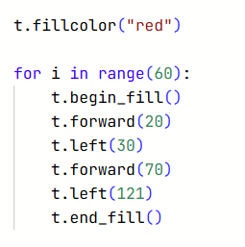
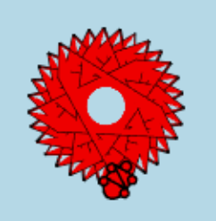
Turtle
Fun exercise! Choose your own adventure and create a cool looking shape with whatever you can do.
If you don’t know where to get started, this is some random shape I’ve made

Slide 23
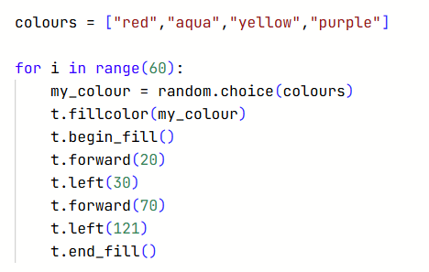

Turtle
Let’s mess around with the fill colour.

Slide 24
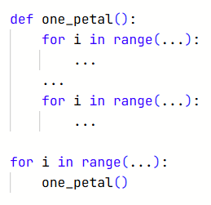
Turtle
Final Challenge: try to make a flower with random coloured
petals
Possible scaffold:

Slide 25
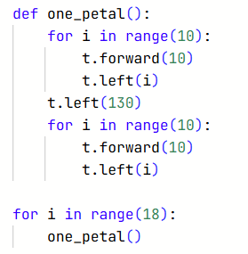
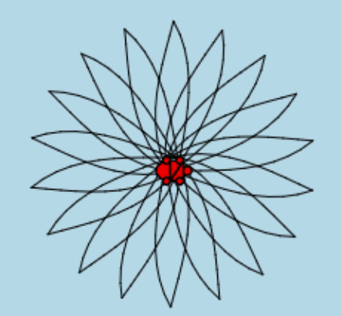
Turtle
My version of the flower frame. There are many other possible flower styles. Now we just need to colour each petal with a random colour.

Slide 26
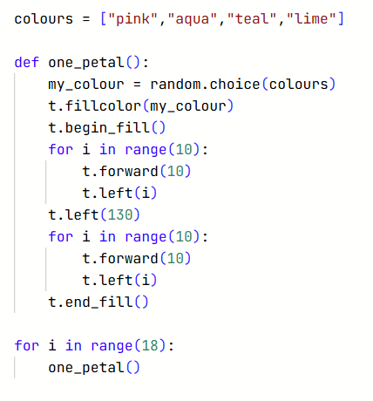
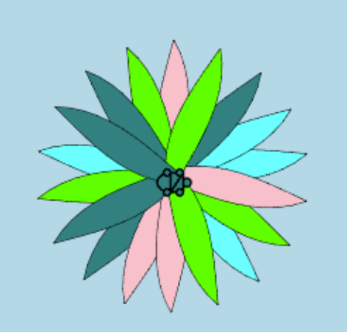
Turtle

